Slide 1

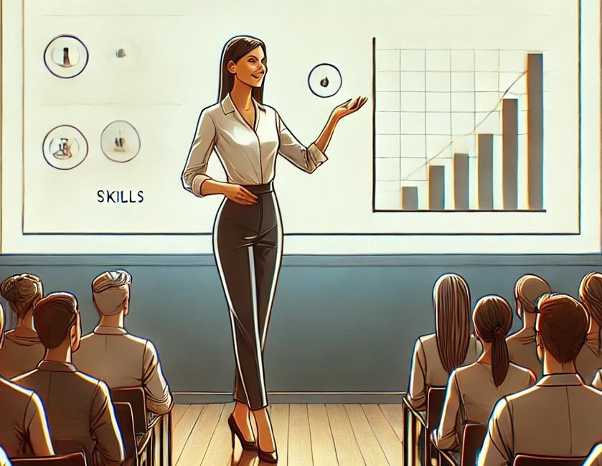
Dr. Nihat Kotluk
The Teaching Support Center (CAPE)
The Center for Learning Sciences (LEARN)
EPFL
Delivering Impactful Presentations/Pitch
Image © generated by ChatGPT-4o

Slide 2

Let’s connect to ttpoll.eu
Enter the session ID hpl2024

Slide 3
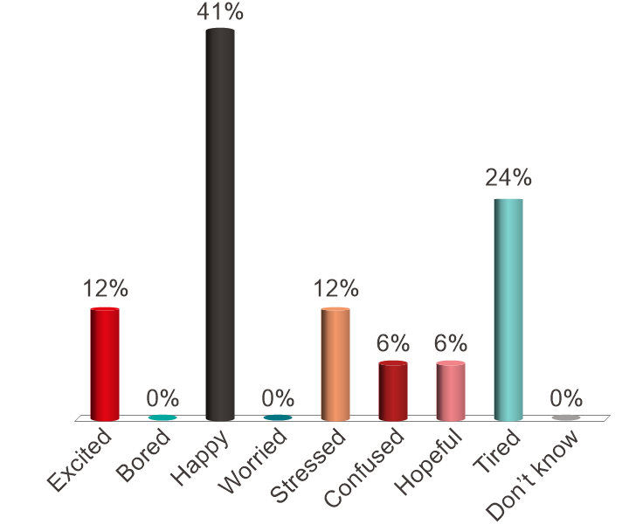
How are you feeling (right now) ?
Excited
Bored
Happy
Worried
Stressed
Confused
Hopeful
Tired
Don’t know

Slide 4
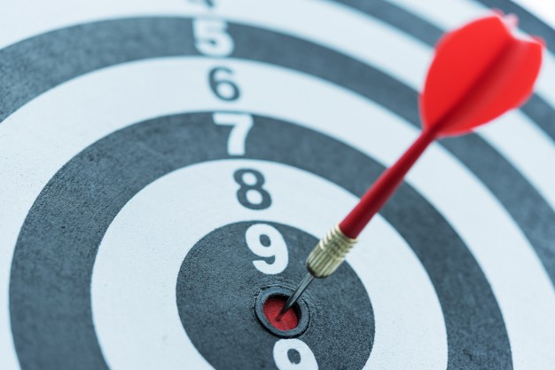
Learning Goals
After this presentation, you will be able to:
Understand the structure of an interactive presentation.
Identify the key elements that make a presentation good.
Deliver a clear and compelling presentation.

Slide 5
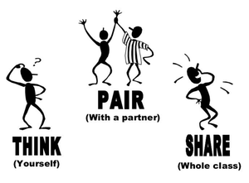
Why do presentation skills matter?
Think about a good and a bad ones!
  Think: Why do you think they were good or bad? (2 min.)
  Pair: With your seat neighbor, compare the reasons you wrote (1 min.)
  Share: Please choose the three most important reasons for the good and then the bad ones (2 min.).

Slide 6

Research Evidence: The Good, the Bad and the Ugly
Clarity
Engagement
Structure
Visuals
Confidence
Storytelling
Confusion
Disconnection
Clutter
Nervousness
Monotony
Overload

Slide 7
Definition of a Presentation
SPEAKER/PRESENTER
MESSAGE
CONTENT
Communication skills
Planning & Supports
Perception, Attention
Motivation, Memory
AUDIENCE/LEARNER
Notes:
for this message to be well transmitted we must take into account two aspects

Slide 8
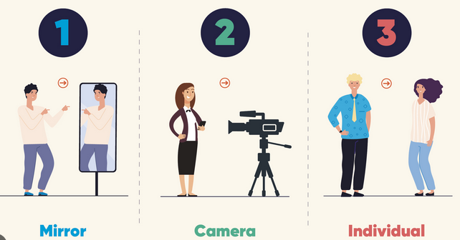
The Speaker/Presenter: Prepare and Practice
Practice is everything:
  Rehearse in front of…
  Get feedback
  Record yourself
  Take notes
  Time yourself (planning).

Slide 9
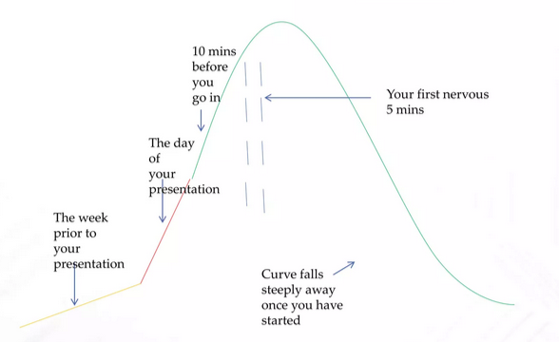
The Speaker/Presenter: The day
Be confident (you practiced)!
Breathe!
Remember you are the expert.
Good news:
  The audience does not know.
Bad news:
  You assume they know.
Fig. the stress curve

Slide 10
The Speaker/Presenter: First impression
People make some (generally first) judgments
  without intentions, awareness, or effort, i.e., spontaneously.
Static cues (e.g., clothing style).
Dynamic cues (e.g., facial expression, posture).
“You don't get a second chance to make a first impression.”
Spontaneous Inferences, Implicit Impressions, and Implicit Theories, Annual Review of Psychology,
https://psycnet.apa.org/doi/10.1177/0146167209346309
Personality judgments based on physical appearance. Personality and Social Psychology Bulletin, https://psycnet.apa.org/doi/10.1177/0146167209346309

Slide 11

The Speaker/Presenter: Effective Beginning
1. Capture their interest and attention.
  Bring along something to share.
  Shock gently the audience.
  Share a story.
  Use a quote.
  A short video.
2. And inform them about the goals.
  …you might wind up someplace else!

Slide 12
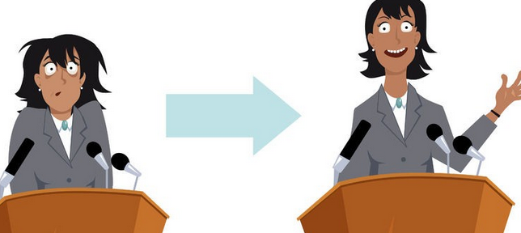
The Speaker/Presenter: Stage vs Podium
How do I best position myself?
Free Stage:
  Be visible.
  Posture (gesture).
  Avoid standing at the same place.
  Avoid unnecessary movements.
A podium:
  Leave your “safe place.”
  Use some non-verbal indicators.
  Be yourself.
  Simply move (but don’t run).

Slide 13
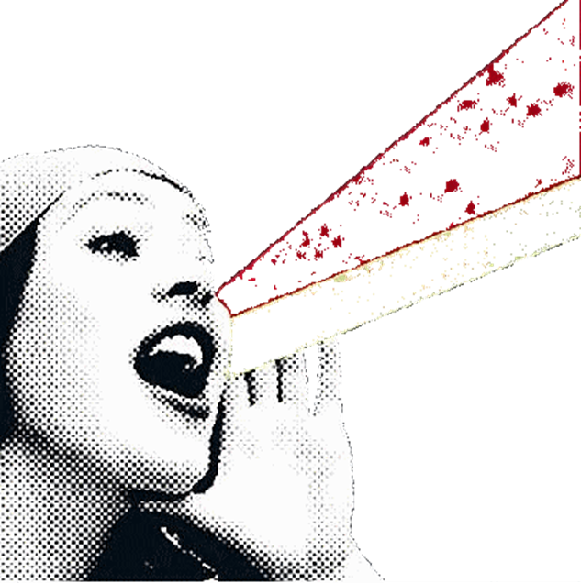
The Speaker/Presenter: The Voice
Do not shout!
Do not be monotonous.
Direct your voice.
Articulate.
Adapt your speed.

Slide 14
Exercise: The sound of your voice
I don’t think this data is analyzed using Y
  (Someone else thought so)
I don’t think this data is analyzed using Y
  (I guess, but I don’t think so)
I don’t think this data is analyzed using Y
  (another data must have been analyzed using that method)
I don’t think this data is analyzed using Y
  (data was analyzed with another method).

Slide 15

The Speaker/Presenter: Eye Contact
Get eye contact.
Vary eye contact.
Include the entire audience.
Don’t just look at the screen!
Don’t just look at the floor!
Don't just look at your index cards!
Don't just look at the laptop!
“The Afghan Girl” by Steve McCurry (1984)

Slide 16
The content/message/structure
Is the
content
appropriate?
Is the content
correct?
Is the
content
complete?

Slide 17
The content/message/structure
Use learning goals! [for selective attention!].
Not many stimuli! [over arousal]
Cut out inessential information! [Extraneous Cognitive Load]
Use ‘from simple to complex’ [for new content or skills!]
Use different types of media [more senses : multisensory]
  Visualize concepts, or procedures.
Not too much new information at the same time! [Miller’s rule]

Slide 18
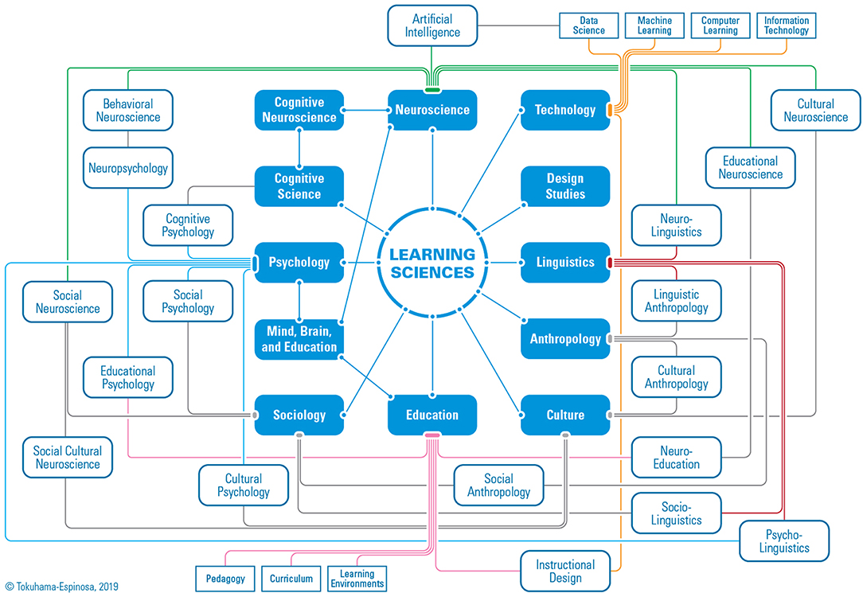
The content/message/structure: ?????
A learning sciences teacher teaches the "How People Learn: Designing Learning Tools I" course to students pursuing a master's degree in engineering. In the third week of the course, the teacher gives the students the following figure about learning sciences.
Learning Sciences is an emerging, interdisciplinary research area that focuses on developing a multi-faceted understanding of learning as it happens in the real world, as well as designing, implementing and improving learning environments.
Learning sciences is the critical theoretical understanding of learning, engagement in the design and implementation of learning innovations, and the improvement of instructional methodologies

Slide 19
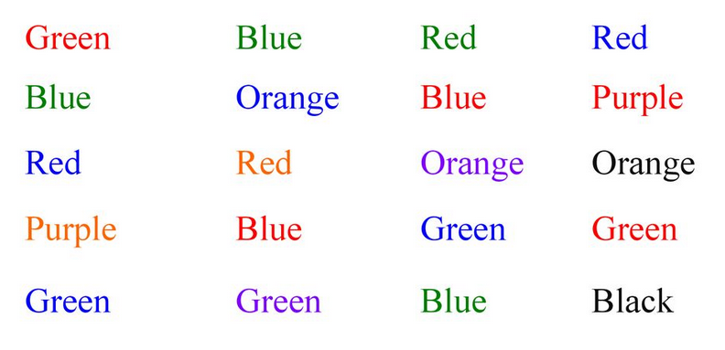
Experiment: Divided Attention
Divided attention refers to situations where a person is attempting to engage in two or more tasks simultaneously.
For example, please try to name the colors of the words (e.g., Green say “Red”).

Slide 20
Bad news: Human attention is a limited resource!
Two different things at the same time is challenging.
When we try to multitask, our brain tends to suffer from cognitive overload.
The Magical Number 7±2 (Miller’s Law) [Miller, 1956]
Keep it simple to reduce cognitive load!

Slide 21
What visuals do?
Help remember
Help make sense of the info
AT A GLANCE
Lead us to understand a solution or result

Slide 22
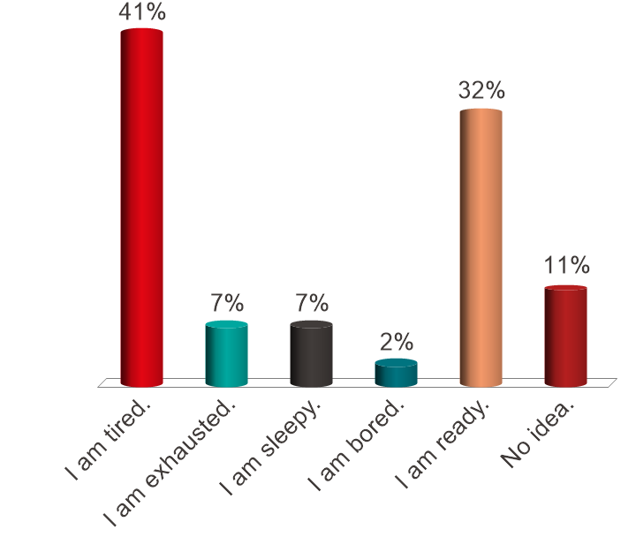
How are you (right now) ?
I am tired.
I am exhausted.
I am sleepy.
I am bored.
I am ready.
No idea.

Slide 23
The audience/learners: Engage them!
the ICAP framework and research evidence.
ICAP | PASSIVE Receiving | ACTIVE Manipulating | CONSTRUCTIVE Generating | INTERACTIVE Dialoguing
LISTENING to a lecture | Listening without doing anything | Repeating or rehearsing; Taking verbatim notes | Reflecting out-loud; Self explaining, Asking questions | Defending and arguing a position in small group
The average scores on the post-test were as follows: | Passive engagement: 55.3% | Active engagement: 62.5% | Constructive engagement: 72.9% | Interactive engagement: 81.9%
The more engagement the more learning

Slide 24
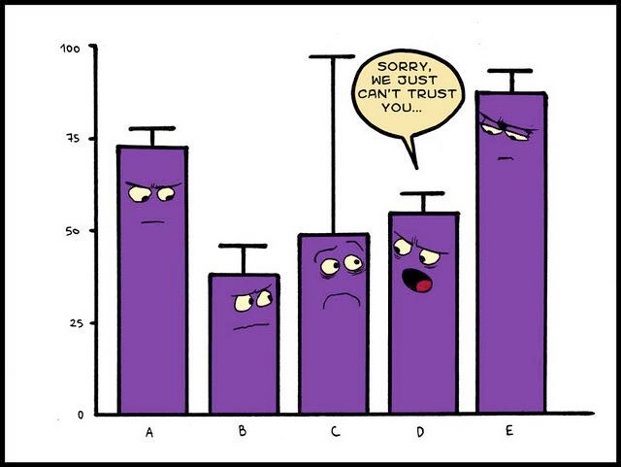
The audience/learners: Interactive
Engage with the audience
Use effective pauses
Prepare interactive presentations
Ask simple questions
Check their attention

Slide 25
Now, are you able to ?
Yes
No
Not sure.
Let’s connect to ttpoll.eu
Enter the session ID hpl2024
Understand the structure of an interactive presentation.
Identify the key elements that make a presentation good.
Deliver a clear and compelling presentation.

Slide 26
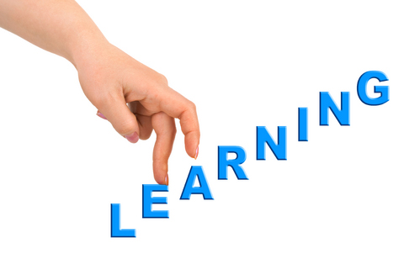
Your take-away
Write down the three most important things you’ve learned today.
What is the first thing your going to do next?

Slide 27
Exercise:
Preparing an effective presentation or pitch
7 slides 2 minutes to present

Slide 28


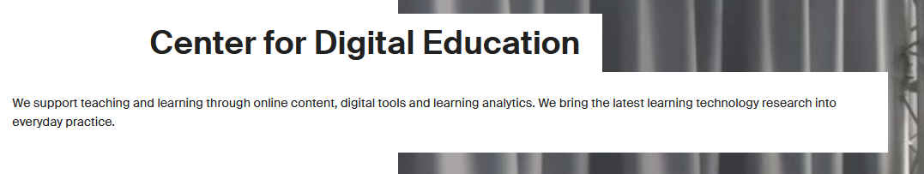
The End.
Thank you.

